Slide 1
We’re Better Together
NWA 2020 Virtual Conference
Tony Rice NASA/JPL SSA Nate Johnson NBC O&O WxOps
Snow forecasts
February 20, 2020

Slide 2
Forecast Evolution for Holly Springs, NC
 |  |  |  |  |  |  |  |  |  |  |  |  |  |  |  |  |  |  |  |  | average
2/19 10am |  | 3-6 |  | 3 |  | 2-4 |  | 2 |  | 1 | 2-3 | 2-4 | 1-3 |  |  | 1 | 1-2 |  | 2-4 |  | 2.3
2/19 6pm | 4-6 | 3-6 |  | 3 |  | 2-4 | 2-3 | 2 |  | 2-3 | 1-3 | 2-4 | 1-3 | 1-3 | 1-3 | 2-3 | 1-3 |  | 2-4 | 1-3 | 2.8
2/20 12:30pm | 4-6 | 2-5+ | 3-5 | 2-5 | 4 | 2-4 | 2-4 | 2-4 | 2-4 | 2-3 | 1-3 | 1-3 | 1-3 | 1-3 | 1-3 | 1-3 | 1-3 | 1-3 | 1-2 | 1-2 | 2.6

Slide 3
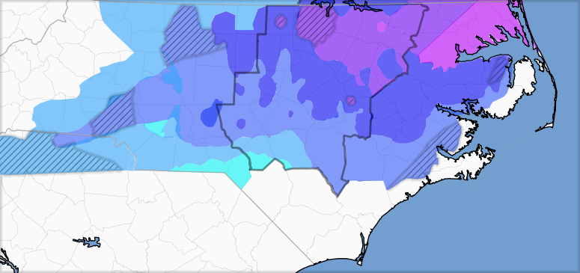
Snowfall Forecast Ensemble
Forecast consensus miss
Consensus across meteorologists in Raleigh-Durham market against spotter reported totals.
Data: WRAL, WTVD, WNCN, Spectrum News, NWS Raleigh

Slide 4





1 event, many colorscales

Slide 5
Call to action

Slide 6
Ensemble Map
<1”
1-2”
2-3”
3+”

